Slide 1
Data Publication
EDS213 - Databases & Data Management
Week 10
Renata Curty & Greg Janée
Research Data Services, UCSB Library
rds@library.ucsb.edu

Slide 2
Learning Objectives
Understand the importance of publishing research data
Identify and select appropriate approaches to data publication
Explain the role of persistent identifiers

Slide 3
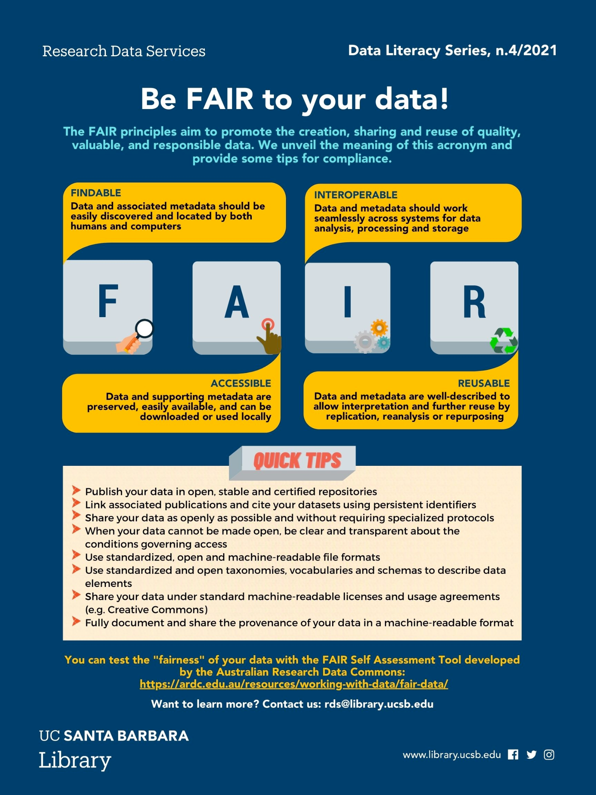
As a Recap…
Not any data!
Well-documented (README + metadata)
Open format
With link to the associated code (if any)
With a explicit license
In a stable repository
With a persistent identifier

Slide 4
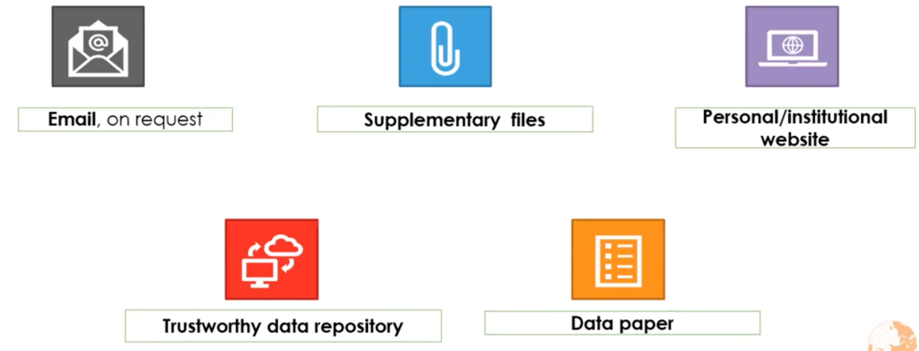

Data Sharing/Publication

Slide 5
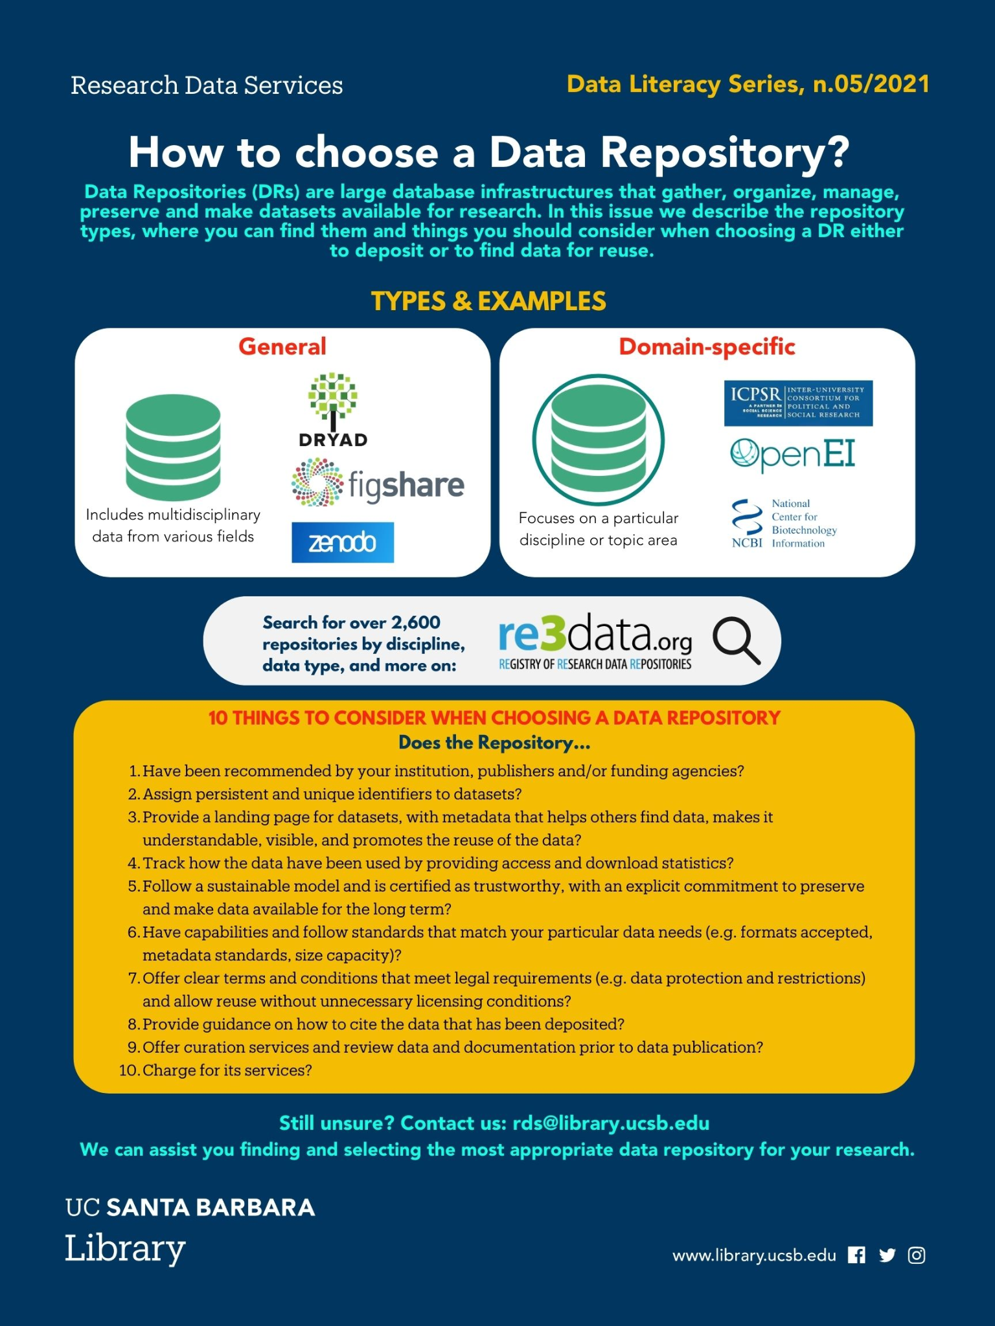
Why a Data Repository?
You can’t lose data that’s in a public data repository
They support understanding, reanalysis and reuse
Data repositories facilitate discovery
Open data demonstrates transparency and rigor
Citations

Slide 6
Give preference to…
A disciplinary repository (re3data.org - 161 in the US)
A repository that…
Funders and publishers endorse/recommend
Offers curation services
Assigns DOIs
Provides a formal citation

Slide 7
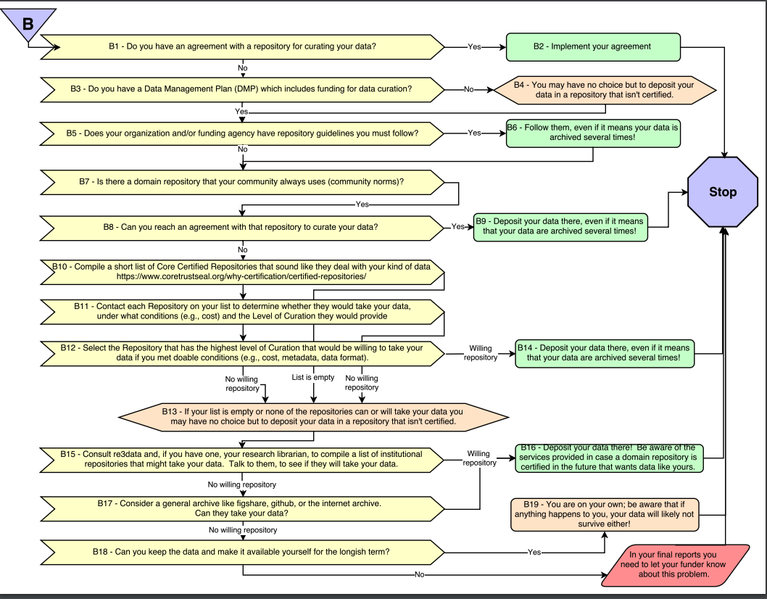
Repository
Selection
Decision
Tree
Enabling FAIR Data Community, Ruth Duerr, Danie Kinkade, Michael Witt, & Lynn Yarmey. (2018). Data Repository Selection Decision Tree for Researchers in the Earth, Space, and Environmental Sciences. Zenodo. https://doi.org/10.5281/zenodo.1475430

Slide 8
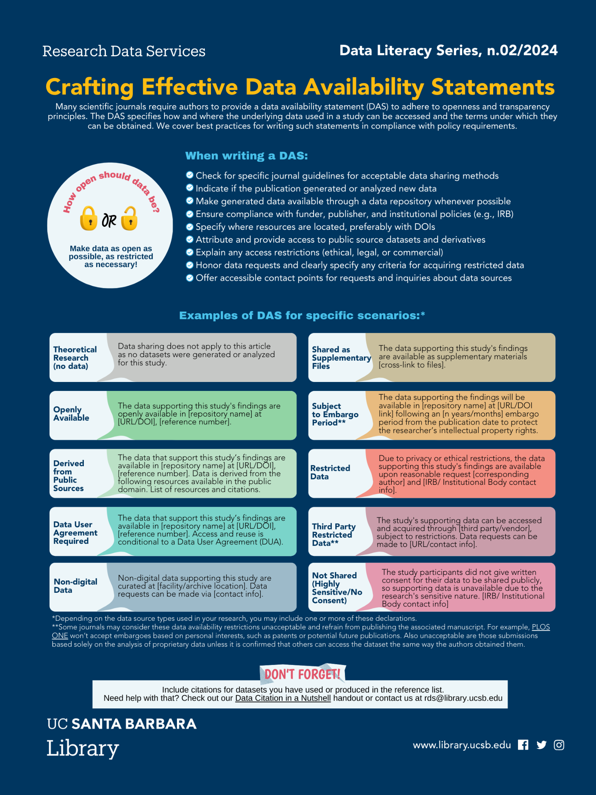
More on Best Practices
Add a data availability statement to related publications and deliverables (even if not required)
Explain any access restrictions (ethical, legal, or commercial)
Honor data requests and clearly specify any criteria for acquiring restricted data
Offer accessible contact points for requests and inquiries about data sources

Slide 9
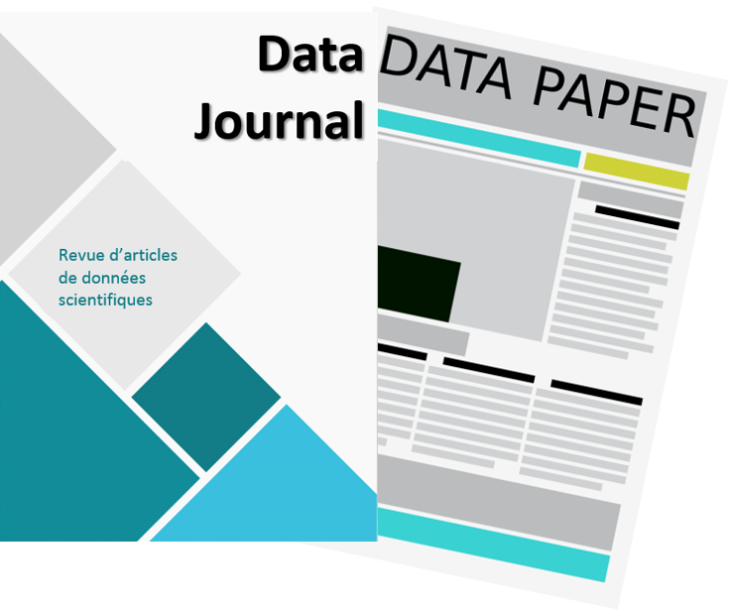
Consider a Data Paper
Data papers can help elevate the visibility of project data promoting the culture of openness and collaboration, while also providing the more traditional incentives for academics.
Not mutually exclusive; the data archive remains relevant
Can be published in dedicated Data Journals or journals that accept this category of submission
List of Relevant Data Journals in Biodiversity: https://www.gbif.org/data-papers
https://www.enago.com/academy/should-you-publish-your-research-data-the-new-trend-of-data-journals

Slide 10
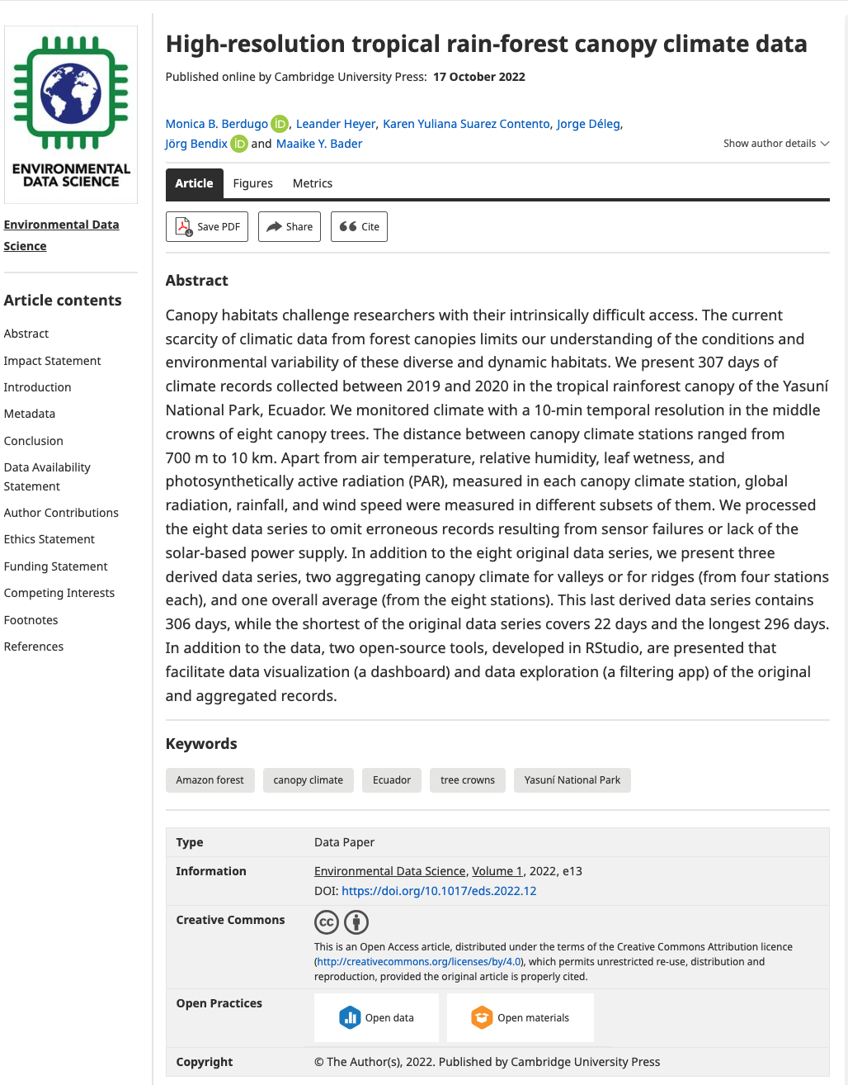
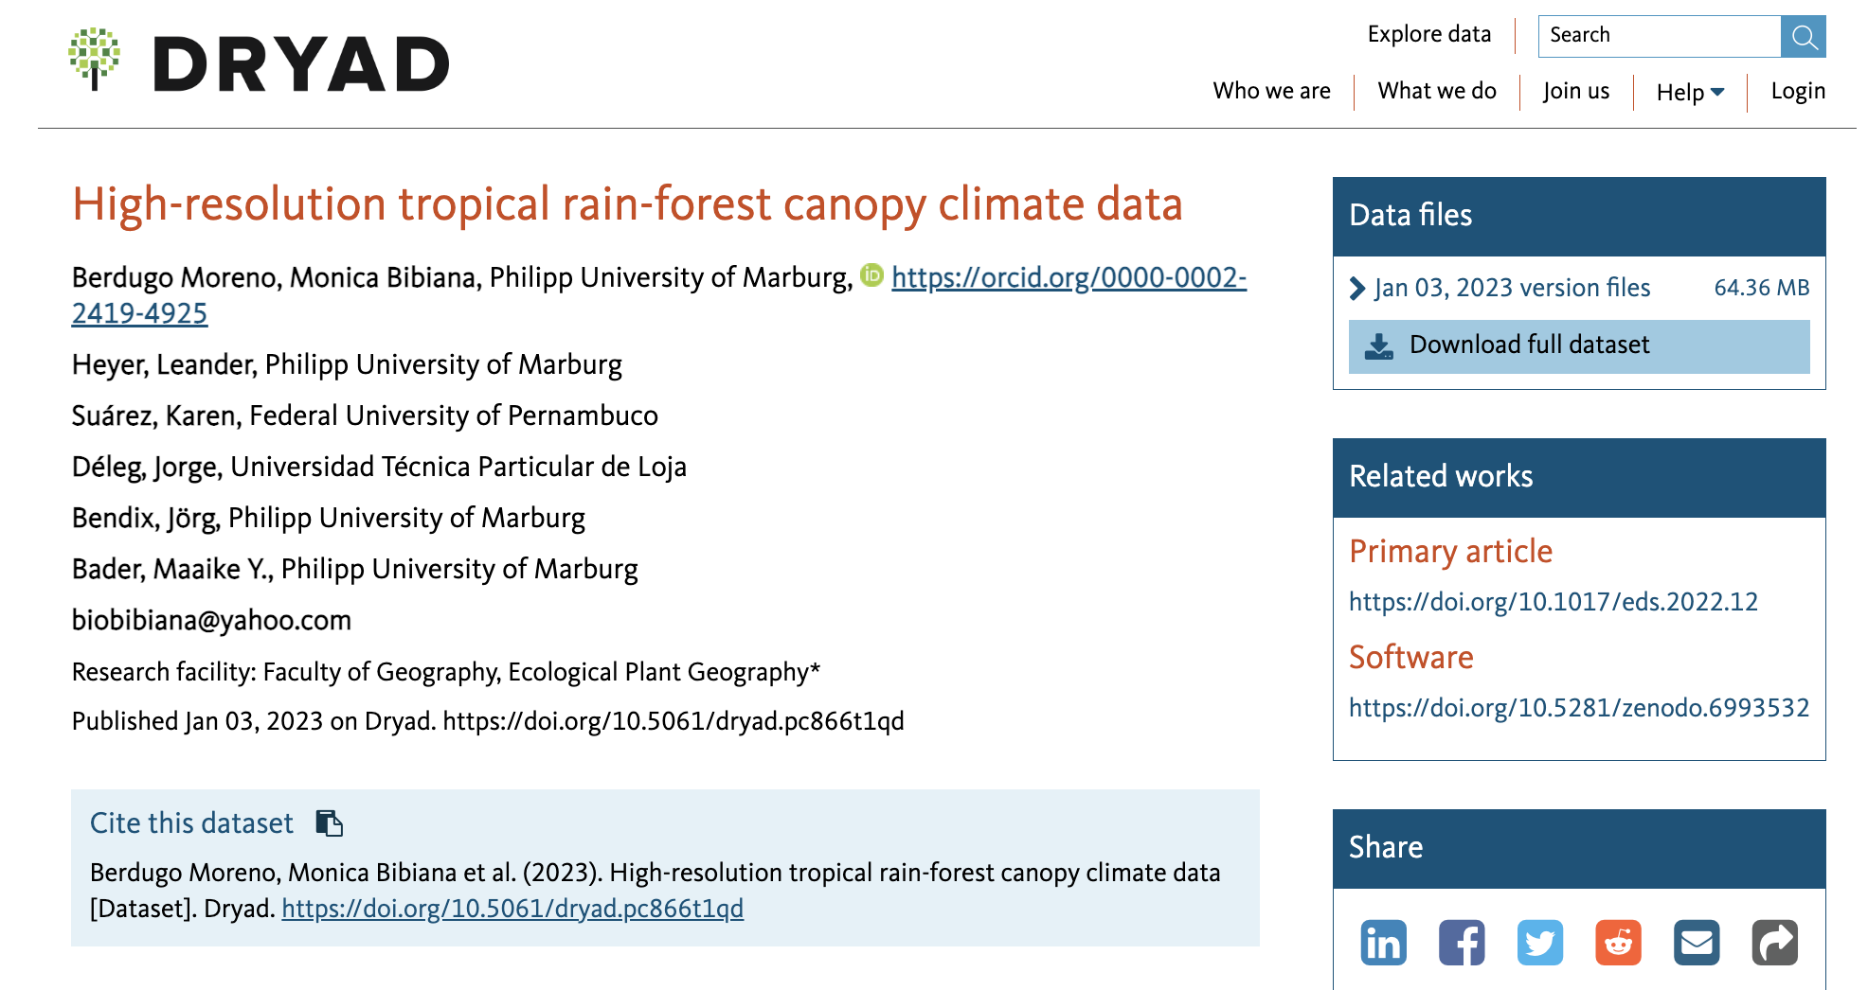
Data Papers
Cross-referenced, using persistent identifiers.
https://doi.org/10.5061/dryad.pc866t1qd
https://doi.org/10.1017/eds.2022.12

Slide 11
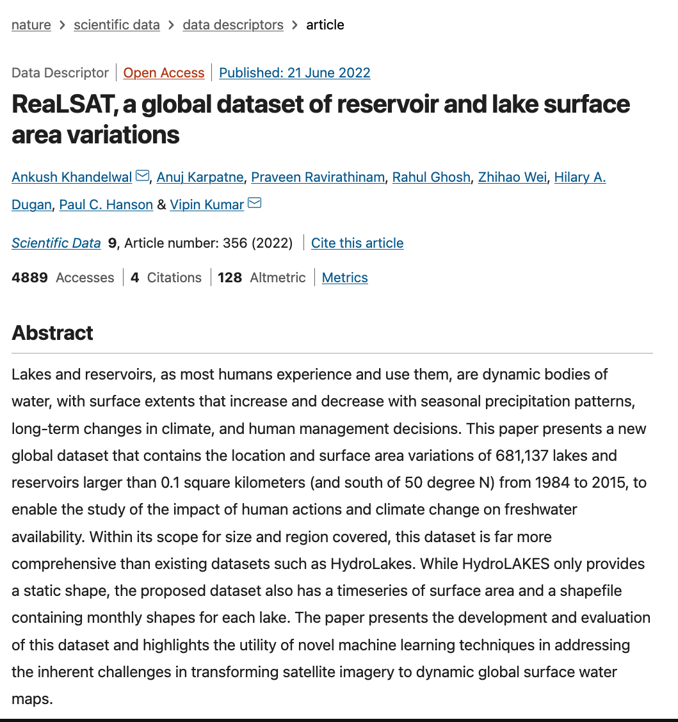
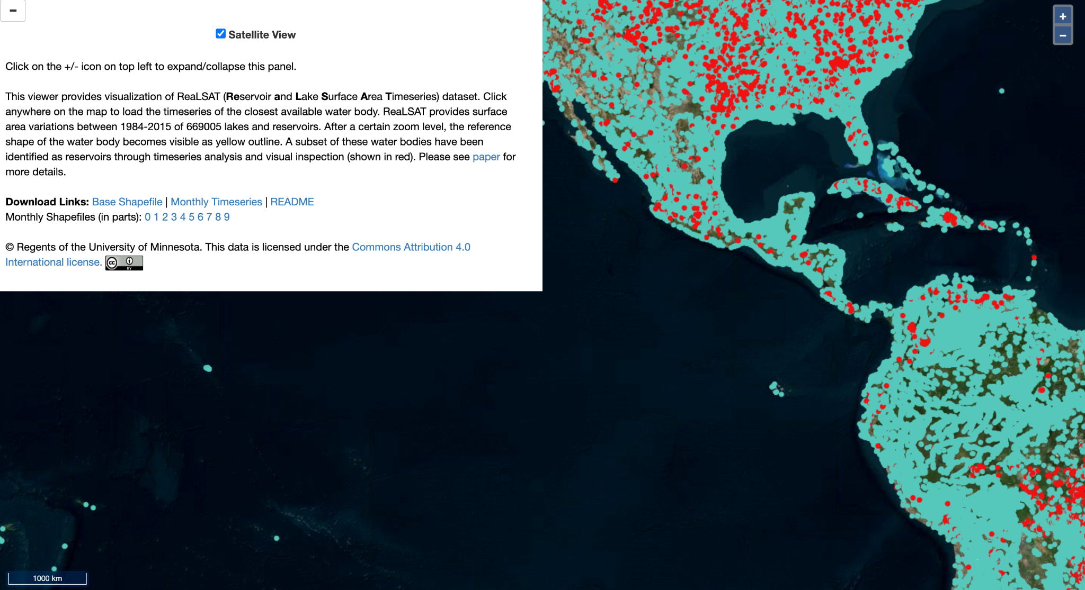

Another example (oh no!)
Data Records
All data records are available for download from Zenodo34 and a zoomable visualization is available at http://umnlcc.cs.umn.edu/realsat.
https://doi.org/10.1038/s41597-022-01449-5

Slide 12

Persistent Identifiers

Slide 13
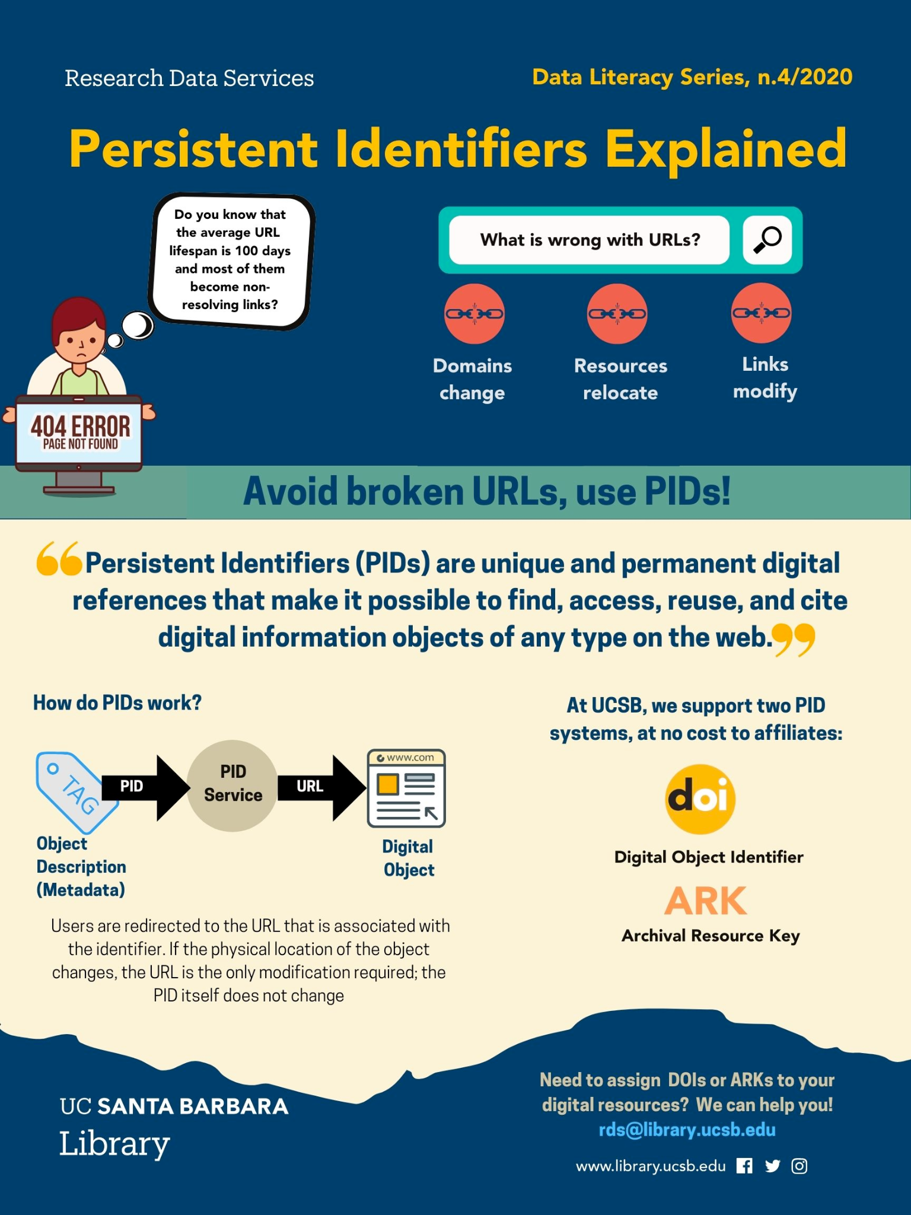
Persistent Identifiers
Most repositories will mint a PId to datasets!
Most journals will mint a PId for papers!
Some repos such as Zenodo and Figshare also create PIds for a variety of other scholarly digital objects (slides, images, code/software)
Released repos on GitHub are assigned a DOI via a Zenodo integration (let’s see how it works!)

